Slide 1

Analysis of Patterns and Dynamics in Patchy Ecological Systems using Cellular Automata Models
Bachelor’s Thesis Presentation
by Chandan R T, IISc UG Physics Major
Guided by:
Prof. Vishwesha Guttal (CES, IISc) and
Prof. Sriram Ramaswamy (Physics, IISc)

Slide 2

Background

Slide 3
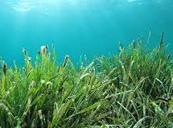
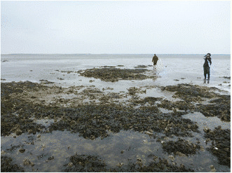

Patchy Ecosystems

Slide 4
Aspects of Patchy Ecosystems
Self Organization
Phase Transitions
Percolating Clusters

Slide 5
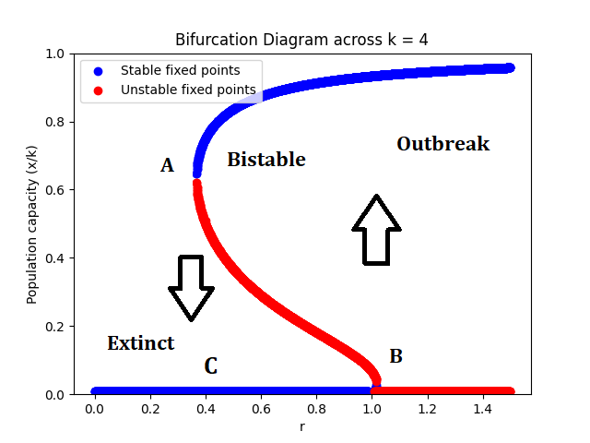
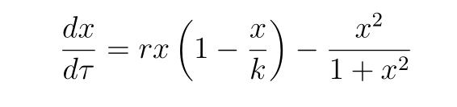
Motivation
Collapse of Ecosystems
Abrupt Transitions and Hysteresis
Lack of Literature
High-res data available

Slide 6
Problem Statement
“ To deduce if the distribution of changes in cluster sizes contains useful information about the dynamics of the system, and whether it can serve as an early warning signal for approaching critical and percolation thresholds ”

Slide 7
Terminology

Slide 8
Cellular Automata Models
Regular N-dimensional lattice of cells
Each cell can be in a finite number of states
Concept of neighbourhood should be defined
Future state of given cell is determined by states of the neighbouring cells
Updates can be probabilistic/deterministic, and synchronous/asynchronous

Slide 9
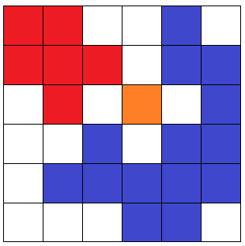
Von-Neumann Clusters
A set of occupied cells belong to the same Von-Neumann cluster if there exists a Von-Neumann path between any two pairs of cells within the set

Slide 10
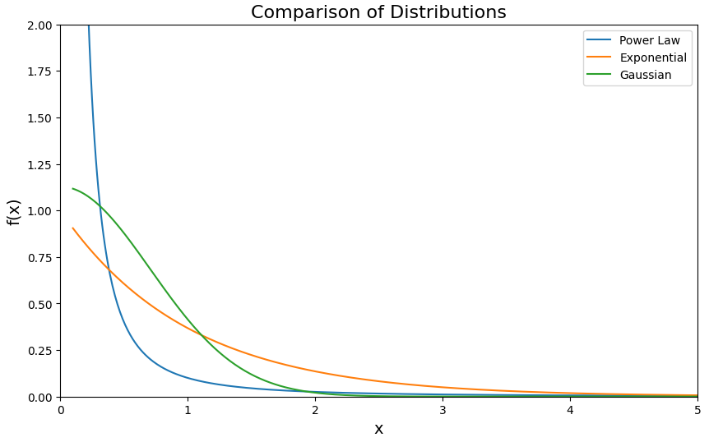
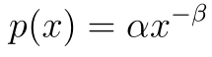
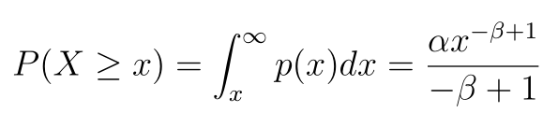
Power-law Clustering

Slide 11
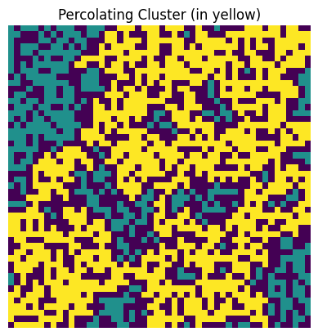
Percolation
Percolation density
Percolation threshold

Slide 12

Models

Slide 13
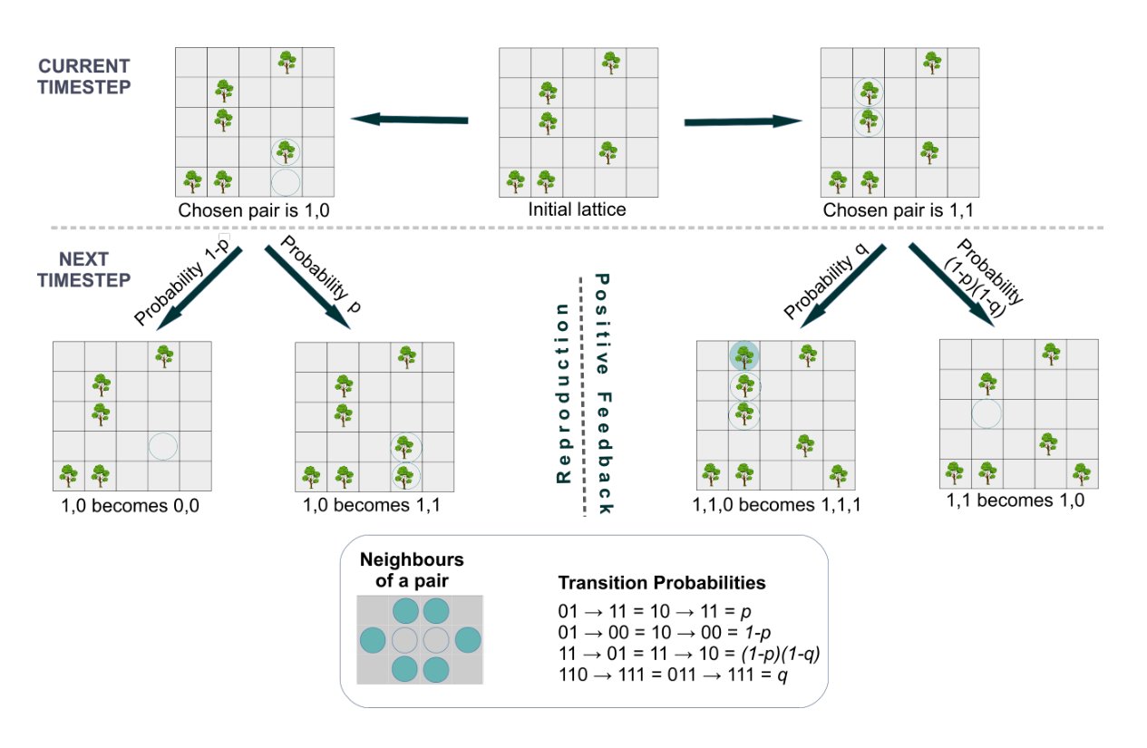
Tri-critical Directed Percolation (TDP)
Sankaran et al: “Clustering and Correlations: Inferring resilience from spatial patterns in ecosystems” Methods in Ecology and Evolution (2019)

Slide 14
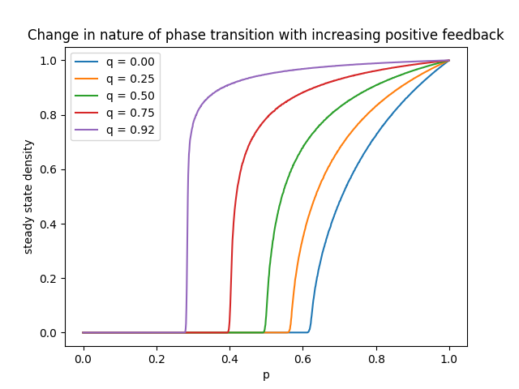
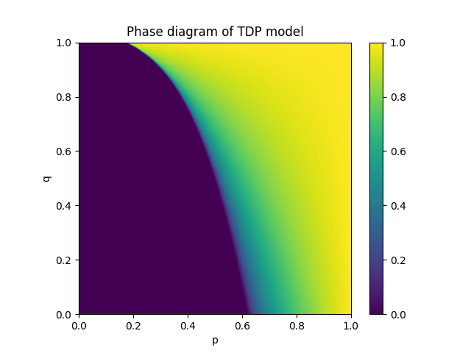
TDP - Phase Transitions

Slide 15
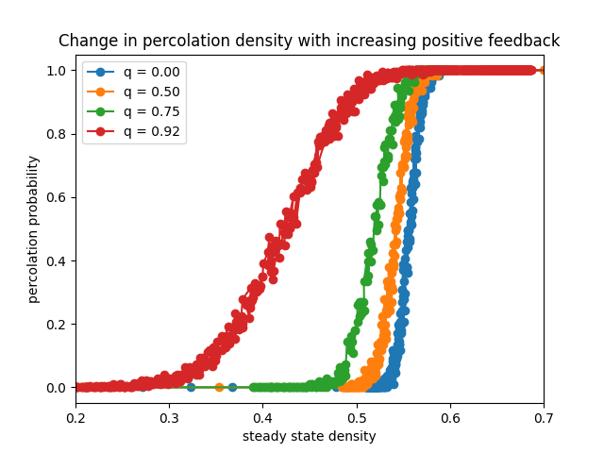
TDP – Percolation Transitions

Slide 16
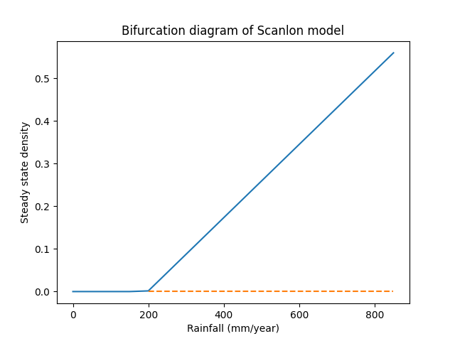
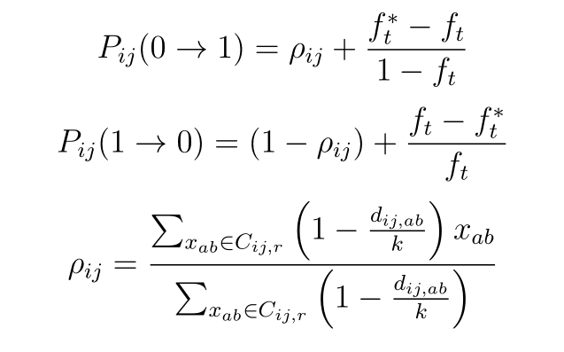
Scanlon’s Model
Scanlon et al: “Positive feedbacks promote power-law clustering of Kalahari vegetation” Nature (2007)

Slide 17
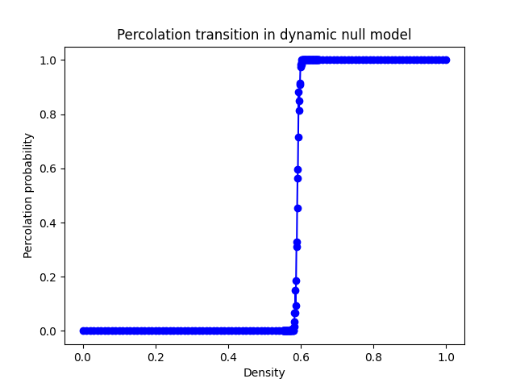
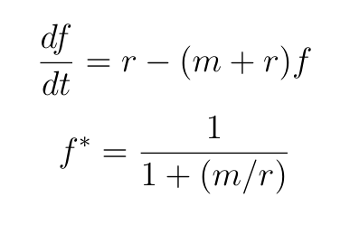
Dynamic Null Model
Kefi et al: “Robust scaling in ecosystems and the meltdown of patch size distributions before extinction” Ecology Letters (2011)

Slide 18

Methods

Slide 19
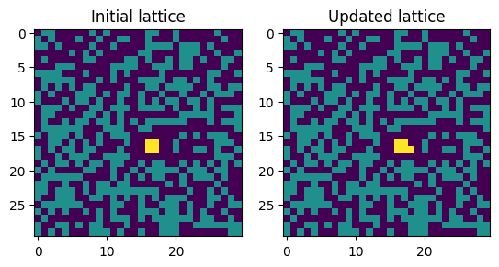
Cluster Tracking Algorithm
Possibilities:
Growth
Decay
Merge
Split
Appearance
Disappearance

Slide 20
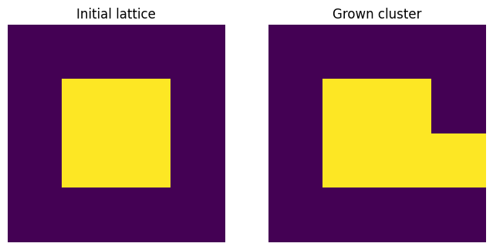
Cluster Growth
Program output:
Type: growth
Size: 4
Change: +1

Slide 21
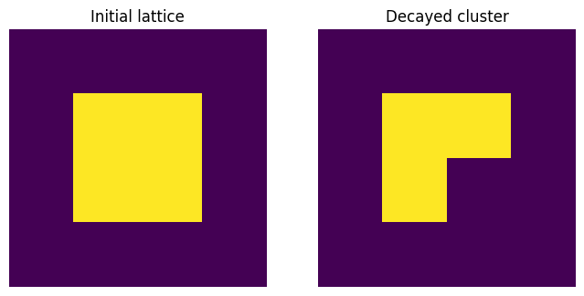
Cluster Decay
Program output:
Type: decay
Size: 4
Change: -1

Slide 22
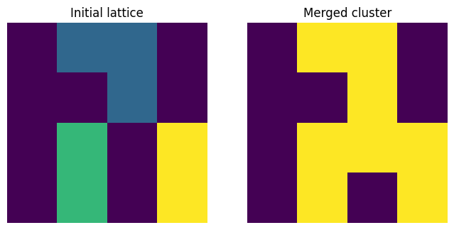
Cluster Merge
Program output:
Type: merge
Initial sizes: 3, 2, 2
Final size: 8
Change: +5

Slide 23
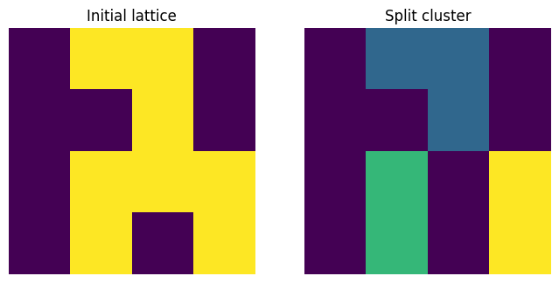
Cluster Split
Program output:
Type: split
Initial size: 8
Final sizes: 3, 2, 2
Change: -5

Slide 24
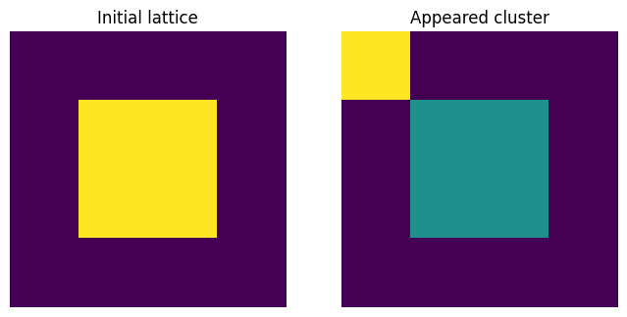
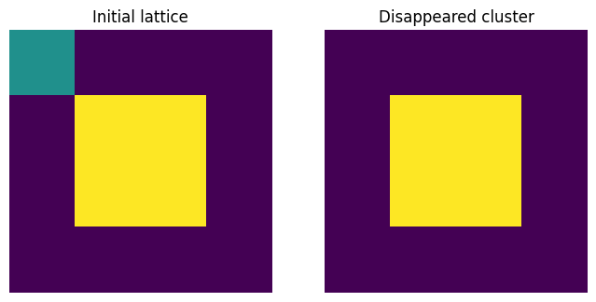
Appearance and Disappearance

Slide 25
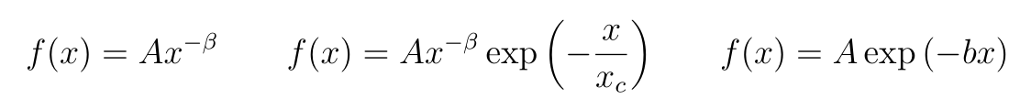
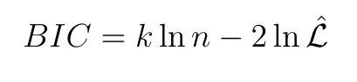
Fitting Procedure
Calculate maximum likelihood estimates for parameters of power-law, truncated power-law (TPL) and exponential fits:
Calculate Bayesian Information Criteria (BIC) from likelihood for each fit. Lower BIC value indicates better fit:
Genin et al: “Monitoring ecosystem degradation using spatial data and the R package spatial warnings” Methods in Ecology and Evolution (2018)

Slide 26
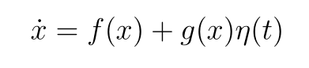
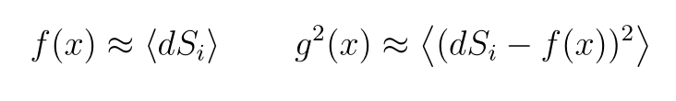
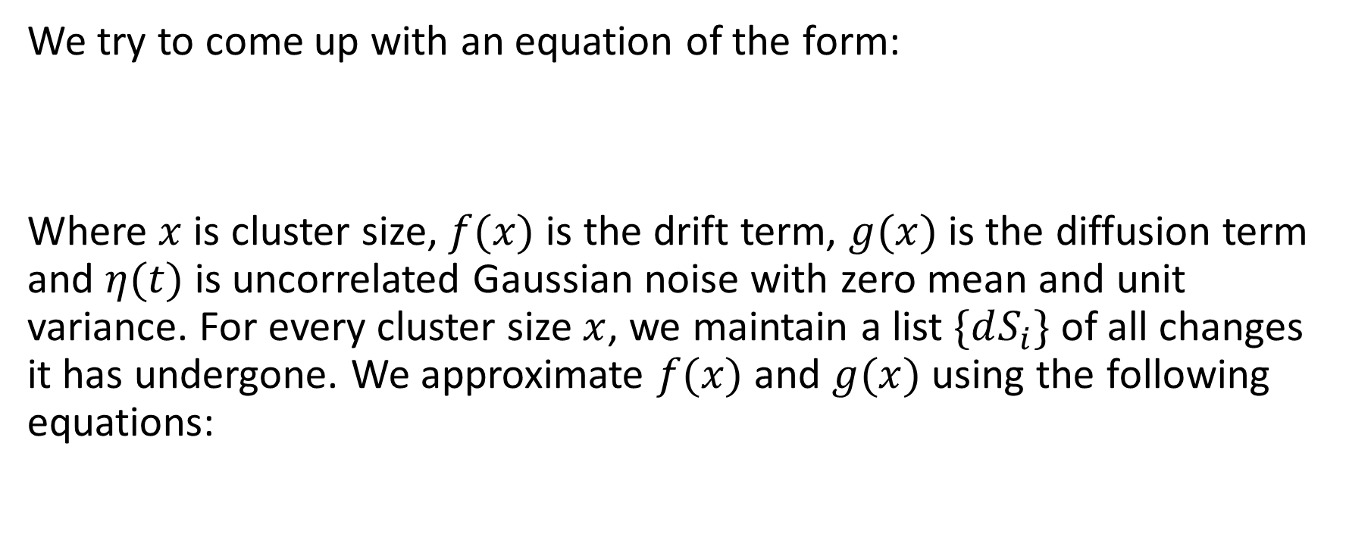
Stochastic Differential Equation (SDE)
We try to come up with an equation of the form:
Where $x$ is cluster size, $f(x)$ is the drift term, $g(x)$ is the diffusion term and $η(t)$ is uncorrelated Gaussian noise with zero mean and unit variance. For every cluster size $x$, we maintain a list $\{dS_{i}\}$ of all changes it has undergone. We approximate $f(x)$ and $g(x)$ using the following equations:

Slide 27
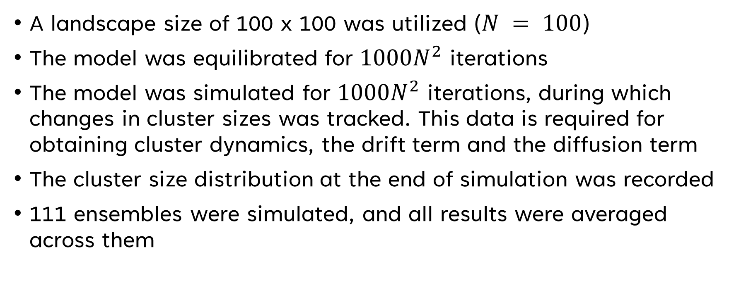
Simulation Details
A landscape size of 100 x 100 was utilized ($N = 100$)
The model was equilibrated for $1000N^{2}$ iterations
The model was simulated for $1000N^{2}$ iterations, during which changes in cluster sizes was tracked. This data is required for obtaining cluster dynamics, the drift term and the diffusion term
The cluster size distribution at the end of simulation was recorded
111 ensembles were simulated, and all results were averaged across them

Slide 28

Results

Slide 29
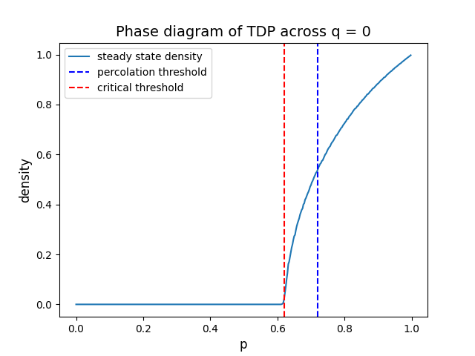

Slide 30
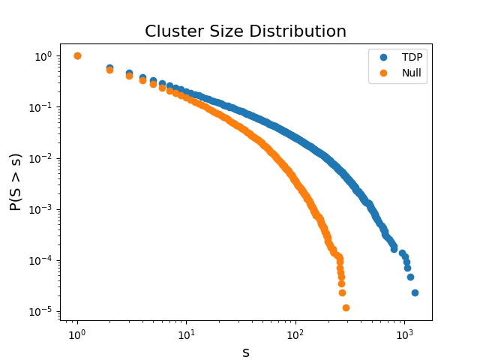
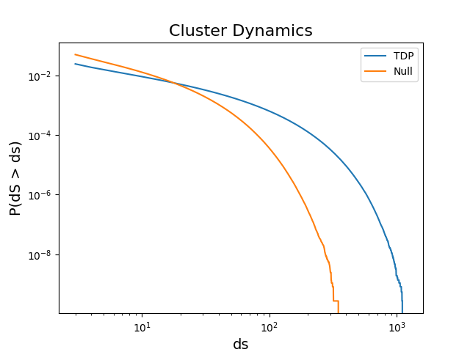
TDP vs Null: below percolation threshold

Slide 31
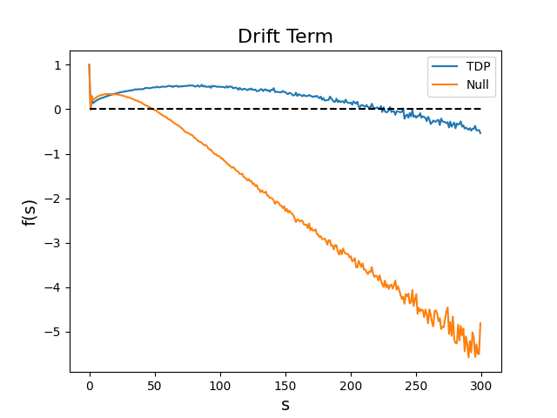
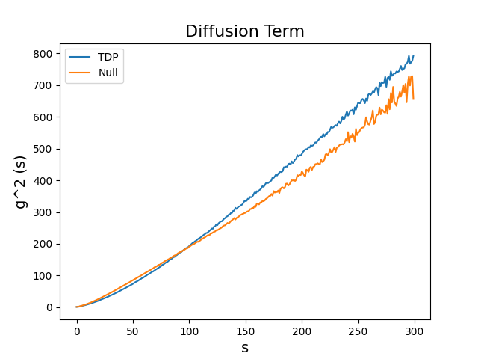
TDP vs Null: below percolation threshold

Slide 32
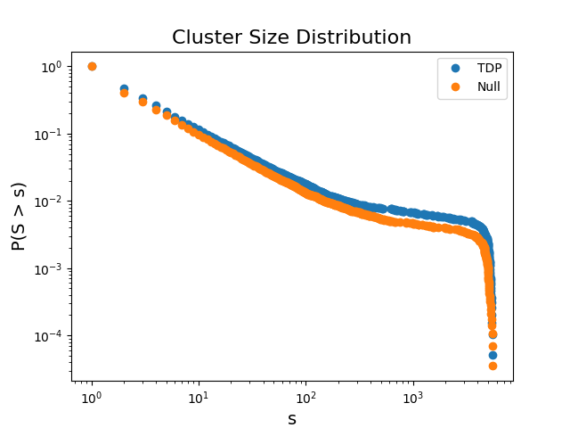
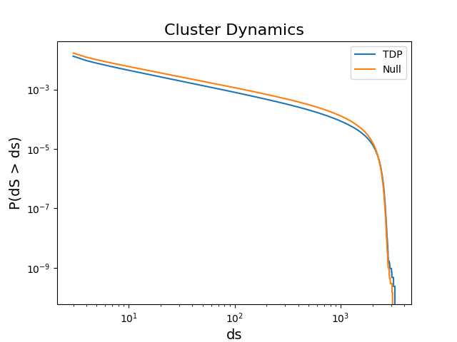
TDP vs Null: above percolation threshold

Slide 33
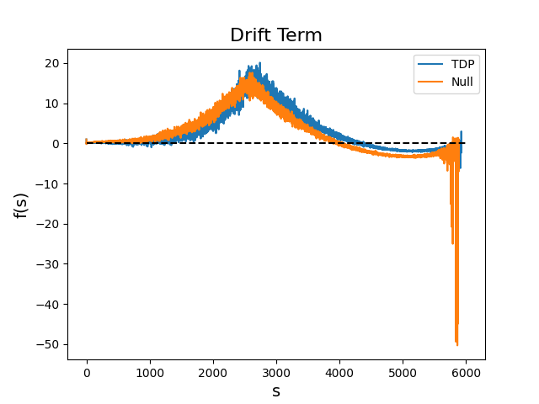
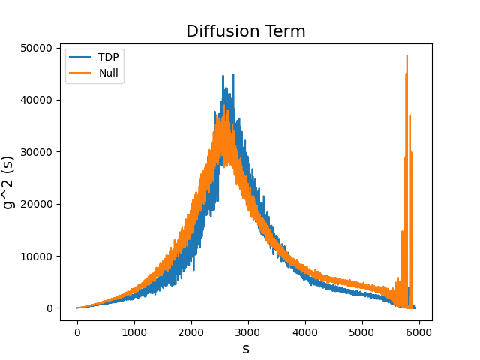
TDP vs Null: above percolation threshold

Slide 35
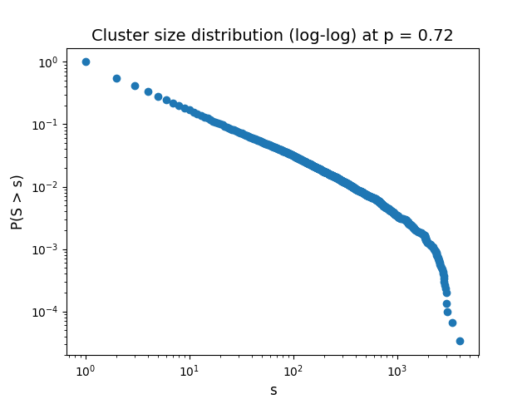
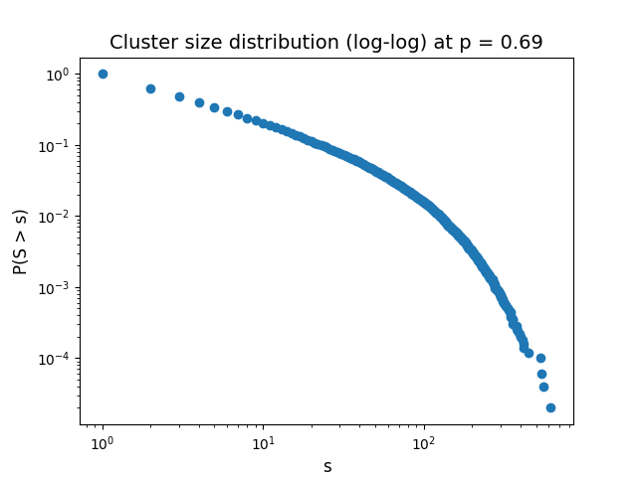
Cluster Size Distribution

Slide 36
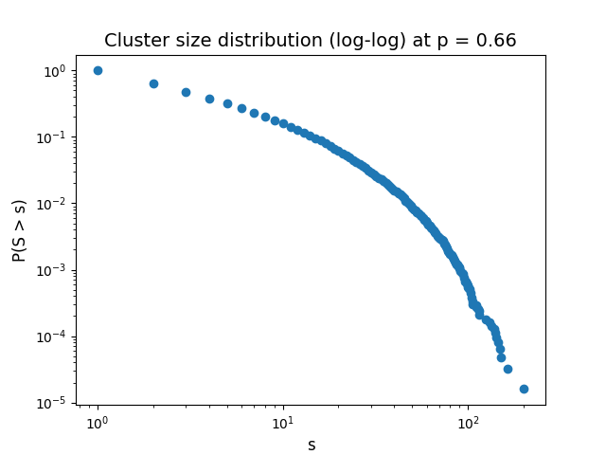
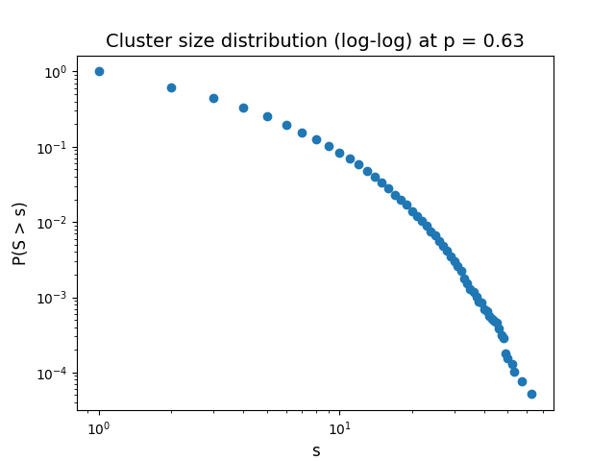
Cluster Size Distribution

Slide 37
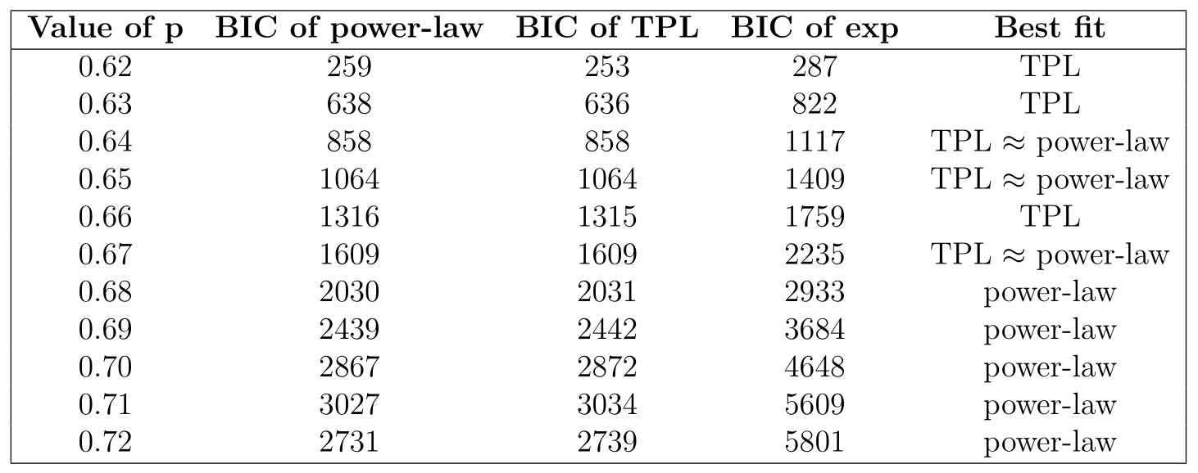
CSD across q = 0

Slide 38
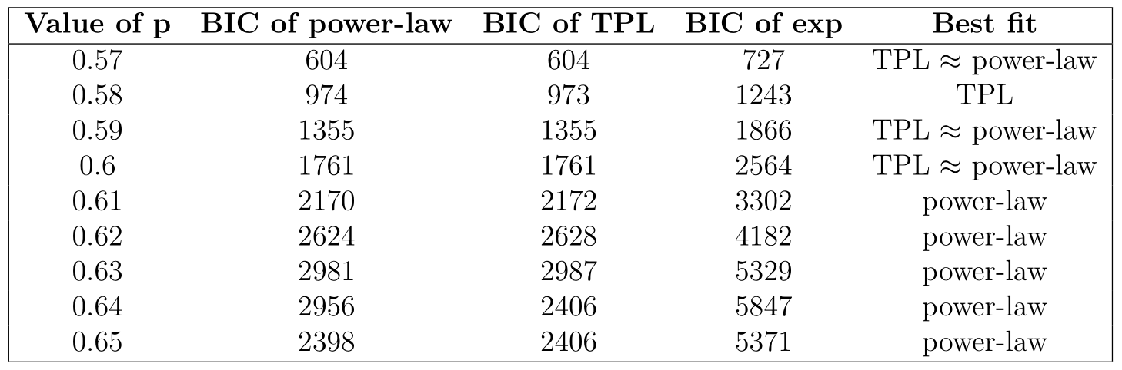
CSD across q = 0.25

Slide 39
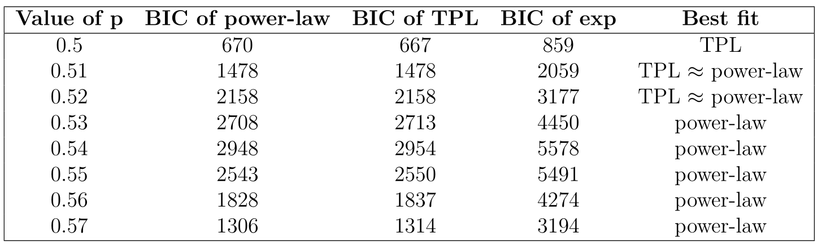
CSD across q = 0.5

Slide 40
Early Warning Signal - 1
As a system nears its critical threshold,
the cluster size distribution changes from
a power-law distribution
to a truncated power-law distribution

Slide 41
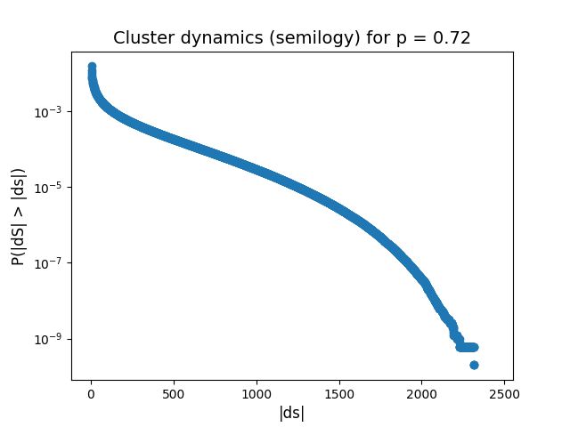
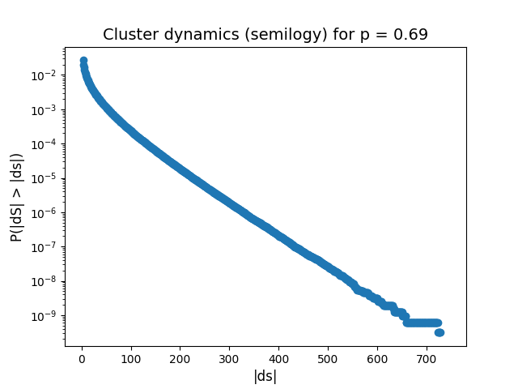
Cluster Dynamics

Slide 42
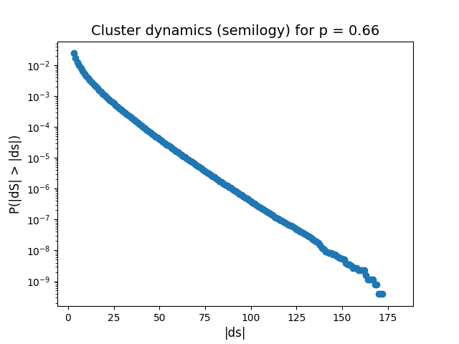
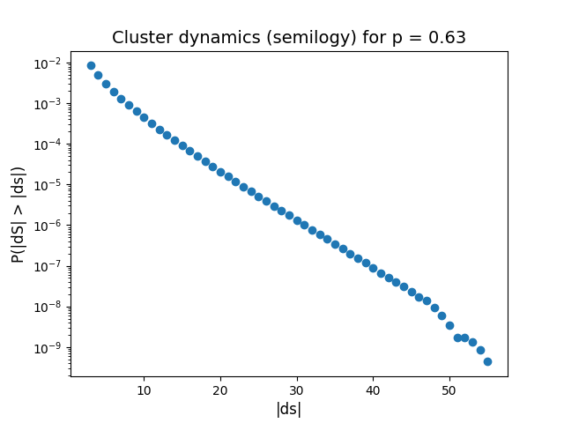
Cluster Dynamics

Slide 43

Cluster Dynamics across q = 0

Slide 44

Cluster Dynamics across q = 0.25

Slide 45

Cluster Dynamics across q = 0.5

Slide 46
Early Warning Signal – 2 (Novel)
A system with an exponential behaviour
in its cluster dynamics
has gone below the percolation threshold and
is poised to undergo a critical threshold

Slide 47


Critical Cluster Size

Slide 48


Critical Cluster Size

Slide 49

Variation of CCS across q = 0

Slide 50

Variation of CCS across q = 0.25

Slide 51

Variation of CCS across q = 0.5

Slide 52
Early Warning Signal – 3 (Novel)
As a system nears its critical threshold,
The stable fixed point of its drift function
(that is, the critical cluster size)
rapidly decreases
Weissmann et al: “Predicting Catastrophic Shifts” Journal of Theoretical Biology (2016)

Slide 53


Some Interesting Observations

Slide 54

Ubiquity of Power-law Behaviour

Slide 55

Ubiquity of Power-law Behaviour

Slide 56

Future Work

Slide 57

Solving Fokker-Planck Equation

Slide 58
Future Work
Fitting of drift and diffusion terms
Analytical estimation of drift and diffusion terms
Self consistency checking of SDEs
Application of results on empirical data
Majumder et al: “Finite size effects, demographic noise, and ecosystem dynamics” The European Physics Journal Special Topics (2021)

Slide 59

Global
Picture

Slide 60
Acknowledgement
I would like to thank:
Prof. Vishwesha Guttal, CES, Department of Biological Sciences, IISc
Prof. Sriram Ramaswamy, Department of Physics, IISc
Thesis committee members
Family members, friends, teachers and mentors
All code and data can be found here:
https://github.com/tee-lab/vegetation-dynamics

